Slide 1

“Workout Tracker”
Task - 2

Slide 2
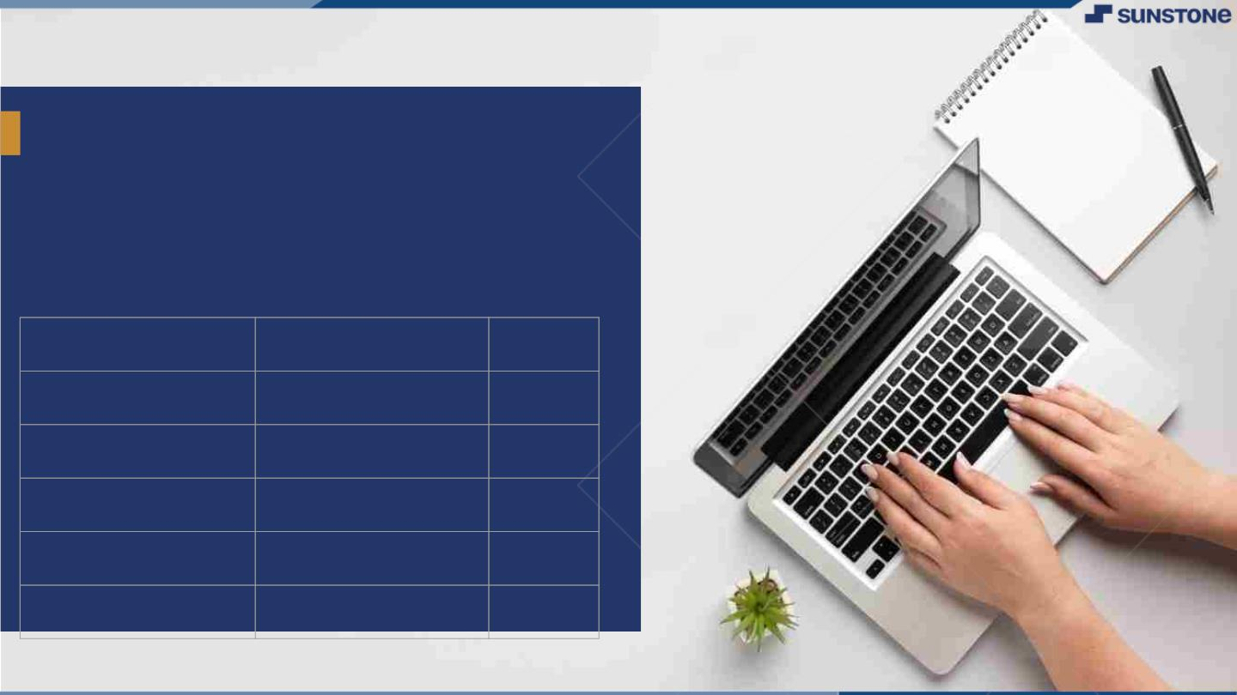
WORKOUT TRACKER
▪
Wearable devices that allow people to monitor and track activities and information related to fitness, such as distance walked and calories consumed.
LMS Username
Name
Batch

Slide 3

Taskꢀ-ꢀ2
CreateꢀUIꢀandꢀimplementꢀvariousꢀcomponentsꢀusingꢀreact
In the Fitness app , you can see a summary of your daily activity, trends, and awards to keep track of your progress.
The Trends area shows your daily data for active calories, walking and running distance, walking pace, and running pace.
IntegrateꢀtheꢀAPIsꢀtoꢀfrontendꢀtoꢀensureꢀtheꢀdynamicꢀfeatureꢀofꢀwebsite
Tracking your workouts keeps you motivated.
Keeping track will help you set realistic goals.
Tracking workouts can lead to better results.
Learning Outcome
By analysing your workout data over time, you can identify which exercises are most effective for you.
Which days of the week you tend to work out the most, and other patterns that can help you optimise your training.

Slide 4

Step-WiseꢀDescription
The device collects data and converts it into steps, calories, sleep quality and general activity you perform through the day.
A fitness tracker is a device that uses sensors to track your orientation, movement, and rotation.
Summaryꢀofꢀyourꢀtask
In the Fitness app , you can see a summary of your daily activity, trends, and awards to keep track of your progress.
The Trends area shows your daily data for active calories, walking and running distance, walking pace, and running pace.

Slide 5
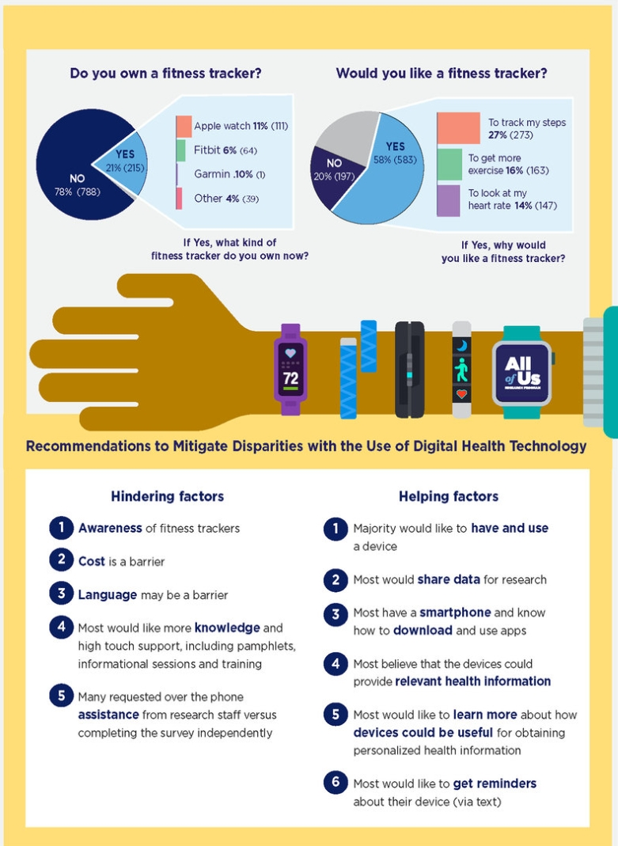
AssessmentꢀParameter

Slide 6

Submission Github
https:/github.

Slide 7


